Slide 1
Multi-Language Alphabetical Classifier
Caleb Federman, Undergraduate
Elias Cassis, Undergraduate
Connor Braun, Undergraduate
Tate Waugh, Undergraduate

Slide 2
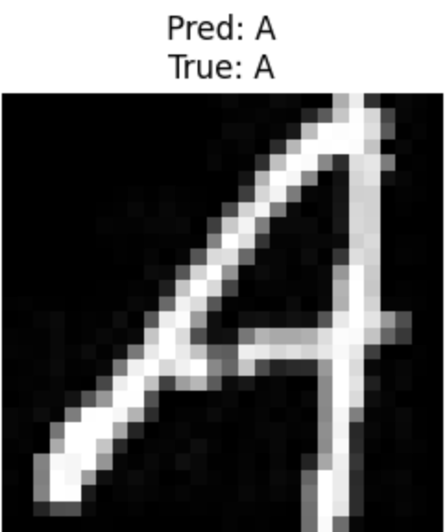
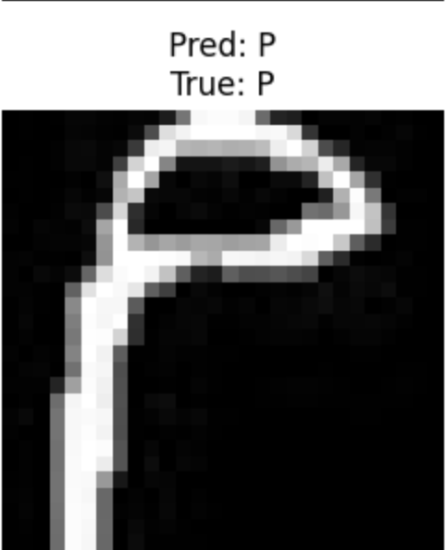
Problem Description
Develop a machine learning framework utilizing Convolutional Neural Networks to recognize and classify characters from diverse alphabets and identify associated languages
Tasks Performed
Handwritten characters from various languages (English / Russian / Arabic)
(See next slide for specific datasets)
Inputs:
Data Loading and preprocessing of English, Arabic, and Russian Datasets
Read image files
Perform any necessary preprocessing (i.e. resizing, grayscale conversion, normalization)
Prepare them in suitable format for CNN
CNN development
Create dataset objects (LetterDataset class)
Split the dataset (Train/Validation/Test)
Initialize the CNN
Train the model (fit/fit_one_epoch fns)
Evaluate model (eval fn)
Display predictions (show_predictions fn)
Desired Output:
Accurate prediction of characters, their alphabets, and corresponding languages.
i.e.,
Notes:
Connor’s Slide

Slide 3
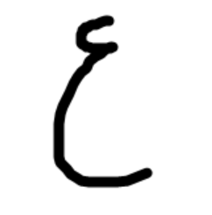


Datasets
Arabic
https://www.kaggle.com/datasets/insafbenlamari/arabic-letters
Format: 28 folders containing handwritten Arabic characters
# of Samples: 8418
Data Partitioning: 70/15/15/ split
Pre-processing: Converted to grayscale and normalized float values. Manually applied one-hot vectors corresponding to language
English
https://www.kaggle.com/datasets/mohneesh7/english-alphabets
Format: 26 folders containing handwritten English characters
# of Samples: 6831
Data Partitioning: 70/15/15/ split
Pre-processing: Converted to grayscale and normalized float values. Manually applied one-hot vectors corresponding to language
Russian
https://www.kaggle.com/datasets/tatianasnwrt/russian-handwritten-letters
Format: Folders containing handwritten Russian characters and corresponding csv with labels
# of Samples: 14190
Data Partitioning: 70/15/15/ split
Pre-processing: Converted to grayscale and normalized float values. Manually applied one-hot vectors corresponding to language

Slide 4
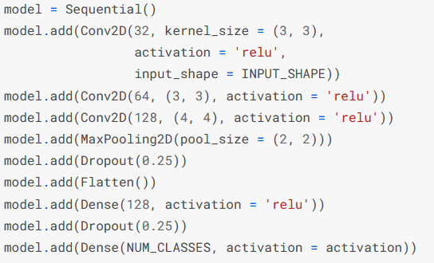
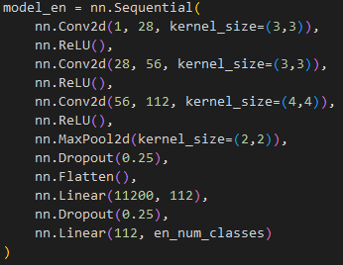
Methods
Prior Work:
Our Method:
Basic handwritten character recognition with CNN:
CNN for Handwritten Letters Classification, BryanB
https://www.kaggle.com/code/bryanb/cnn-for-handwritten-letters-classification
Single language classification.
Utilizes different backgrounds for letters for better identification.
~86% accuracy, ~99% accuracy with additional background consideration.
More Complex Models:
LSTM & Elephant Herding Algorithm:
Uses detailed preprocessing with multiple algorithms before apply an LSTM to classify letters from English, Kannada, and Arabic.
Accuracy: 96.66%, 96.67%, and 99.93%
https://www.sciencedirect.com/science/article/abs/pii/S0167865522001490
Cross-Lingual Recognition:
An exploration of classification and translations in one process rather than two separate discrete processes.
https://www.researchgate.net/publication/361356717_Cross-Lingual_Text_Image_Recognition_via_Multi-Hierarchy_Cross-Modal_Mimic
Create CNN for each language (en, ar, rn).
Create CNN for the combination of languages.
Apply multiple 2d convolutions on the image with increasing channels and periodic relu activations to best select features.
Pool the results to keep the model focused and reduce unnecessary complexity & training time.
Utilize dropout to keep the model from unnecessary complexity and break down to classifying needed letters using linear layers.
Compare performance of several different classification routes:
Individual classification.
With/without transformation (slight random affine)
Grouped CNN classification.
With/without transformation (slight random affine)
Grouped confidence based classification.
Issues & Parameter Selection
Learning rate: Slight decrease for cleaner convergence.
Initialization of weights: Initial std too small, increased till models began more confidently learning.
model
goal
issues/PS

Slide 5
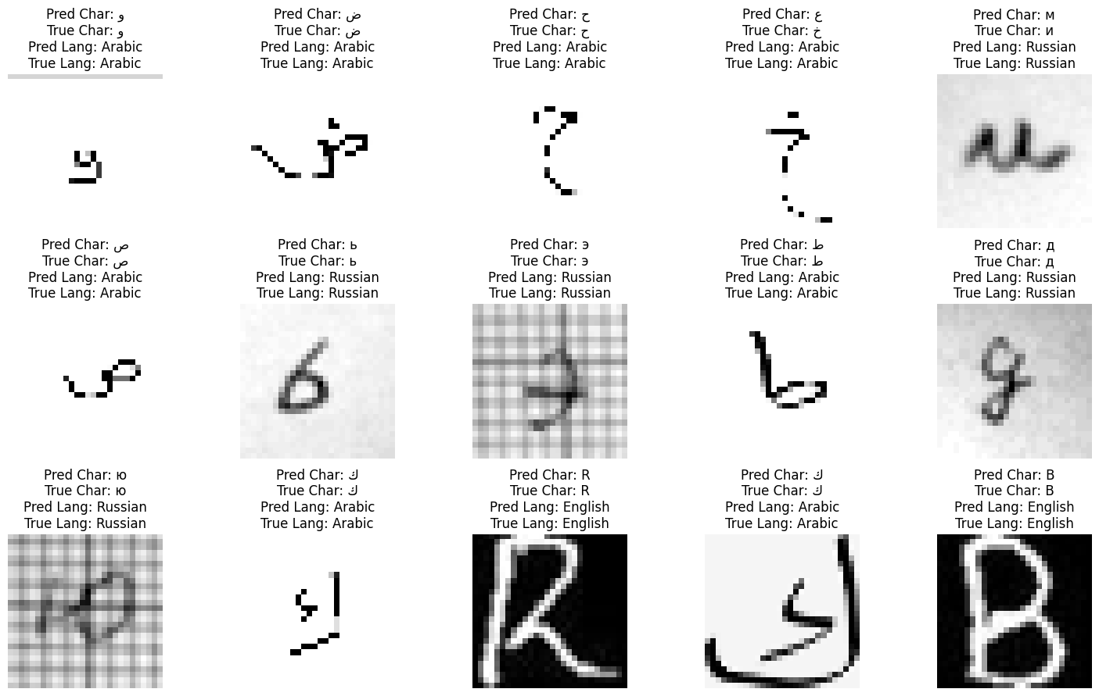
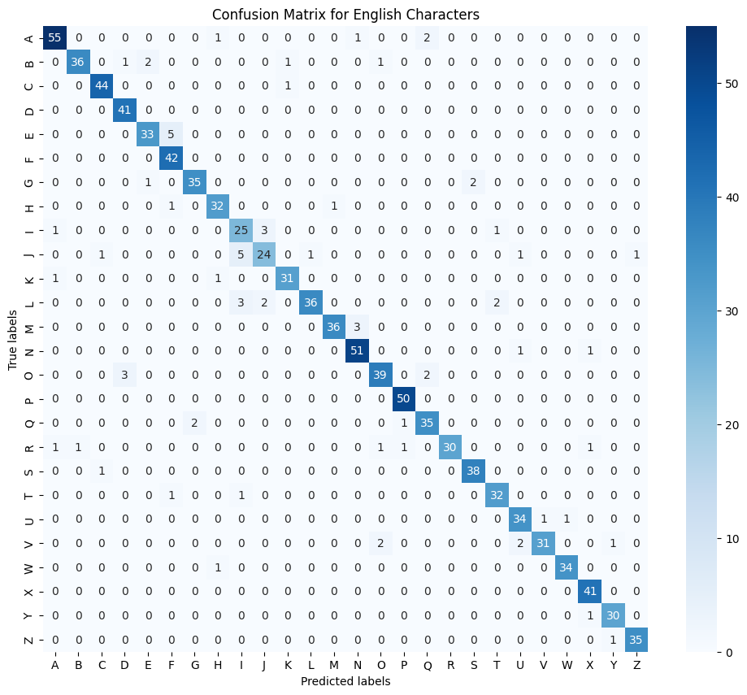
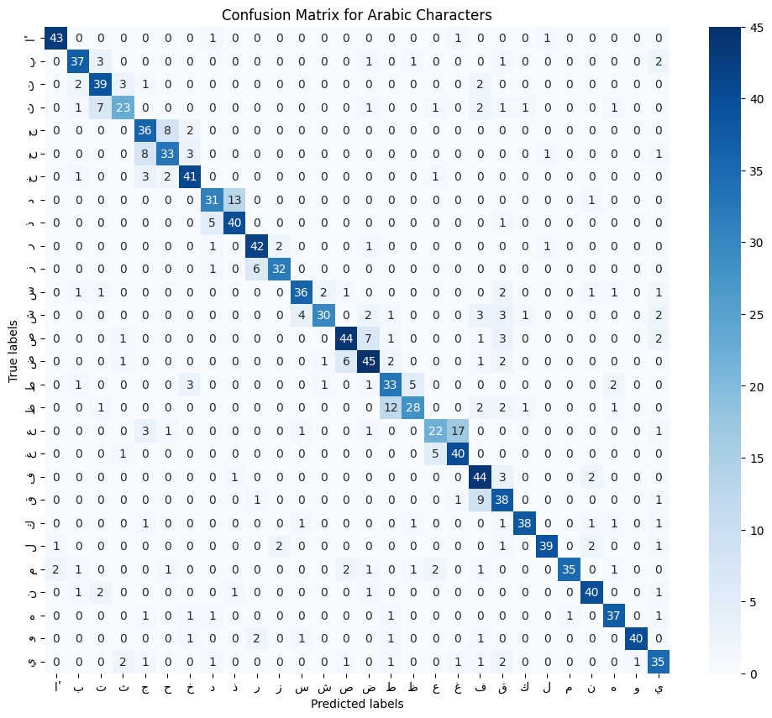
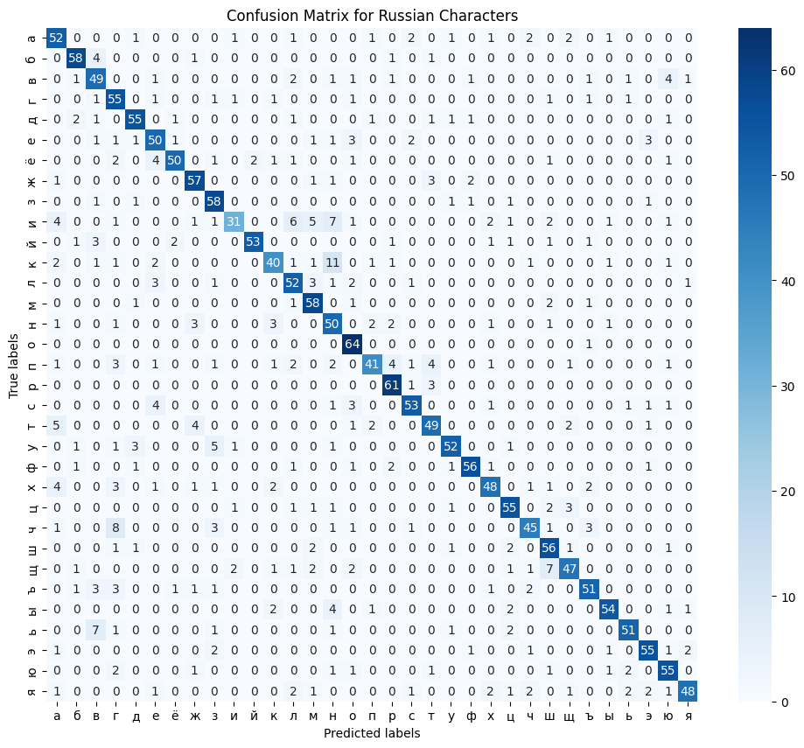
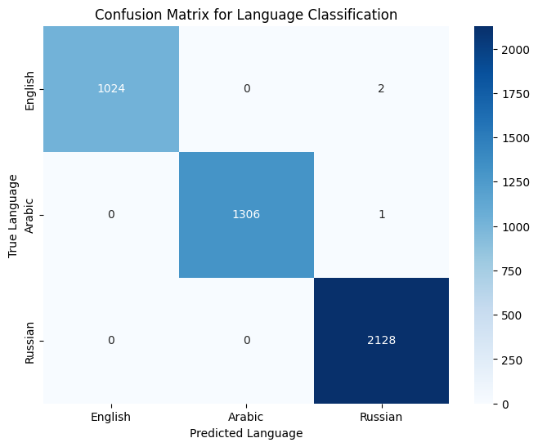
Results
OUTPUT
CONFUSION MATRICES
ACCURACIES
 | Transformations | No Transformations
English | 85.29% | 86.12%
Arabic | 67.39% | 70.10%
Russian | 70.93% | 71.65%
Combined | 80.62% | 73.73%
Confidence | 44.87%

